Slide 1
The Many-to-Many Relationship
Chapter 5

Slide 2
Chapter Summary
Model a M:M relationship between two entities
Define a database with a M:M relationships
Write queries to extract information from a database with M:M relationships

Slide 3
Index of Lessons and Chapter Problems
Conceptual modelling - ERD
1 a, b*, c, d*, e, 2, 8
Joins
3 a – e (use IN or NOT IN for c, d)
Exists/Not Exists
3c, d
Divide
7f
Set operations
7 a - j

Slide 4
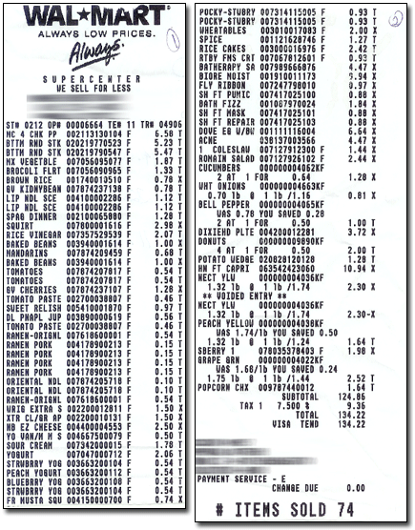
Lesson 1
Notes:
http://www.mdmproofing.com/iym/products/receipt-splitter/

Slide 5
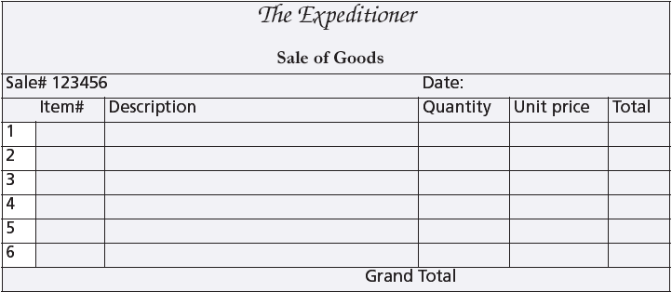
A sales form

Slide 6
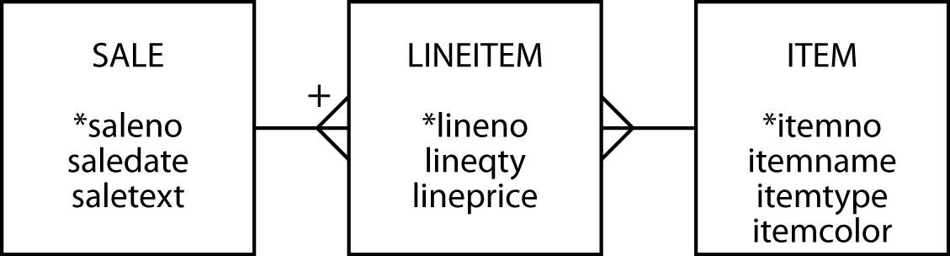
The many-to-many relationship
Create a third entity to map an m:m relationship
An associative entity
The + on the crow's foot indicates that LINEITEM is identified by concatenating saleno and lineno
LINEITEM is known as a weak entity, and it has an identifying relationship with SALE

Slide 7
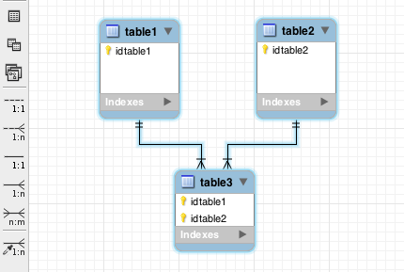
The many-to-many relationship
MySQL Workbench
m:m symbol

Slide 8
Preference settings
Foreign key same name as primary key
Associative table name of form tableA_tableB

Slide 9
The many-to-many relationship
MySQL Workbench
Identifying
relationship
Non-identifying
relationship

Slide 10
Why a third entity?
Store data about the relationship
Think of an m:m as two 1:m relationships

Slide 11
Creating a relational database
Same rules apply
The associative table has two foreign keys
One for each of the entities in the m:m relationship
A foreign key can also be part of the primary key of an associative entity
lineitem
lineno | lineqty | lineprice | saleno | itemno
1 | 1 | 4.50 | 1 | 2
1 | 1 | 25.00 | 2 | 6
2 | 1 | 20.00 | 2 | 16
3 | 1 | 25.00 | 2 | 19

Slide 12
Creating a relational database
CREATE TABLE sale (
saleno INTEGER,
saledate DATE NOT NULL,
saletext VARCHAR(50),
PRIMARY KEY(saleno));
CREATE TABLE item (
itemno INTEGER,
itemname VARCHAR(30) NOT NULL,
itemtype CHAR(1) NOT NULL,
itemcolor VARCHAR(10),
PRIMARY KEY(itemno));
CREATE TABLE lineitem (
lineno INTEGER,
lineqty INTEGER NOT NULL,
lineprice DECIMAL(7,2) NOT NULL,
saleno INTEGER,
itemno INTEGER,
PRIMARY KEY(lineno,saleno),
CONSTRAINT fk_has_sale FOREIGN KEY(saleno) REFERENCES sale(saleno),
CONSTRAINT fk_has_item FOREIGN KEY(itemno) REFERENCES item(itemno));

Slide 13
Class Exercise 1
A keen field hockey fan wants to keep track of which countries won which medals in the various summer Olympics for both the men’s and women’s events
Design a data model
Create the database
Populate with data for the last two Olympics
http://en.wikipedia.org/wiki/Field_hockey_at_the_Summer_Olympics
Conceptual modelling - ERD
Textbook problems: 1 a, b*, c, d*, e, 2, 8

Slide 14
A three table join
Lesson 2
List the names of the three tables after FROM
Specify two matching conditions with the associative table in both join conditions
SELECT * FROM sale, lineitem, item
WHERE sale.saleno = lineitem.saleno
AND item.itemno = lineitem.itemno;

Slide 15
A three table join
List the names of items, quantity, and value of items sold on January 16, 2011
SELECT itemname, lineqty, lineprice, lineqty*lineprice
AS total FROM sale, lineitem, item
WHERE lineitem.saleno = sale.saleno
AND item.itemno = lineitem.itemno
AND saledate = '2011-01-16';
itemname | lineqty | lineprice | total
Pocket knife—Avon | 1 | 0.00 | 0.00
Safari chair | 50 | 36.00 | 1800.00
Hammock | 50 | 40.50 | 2025.00
Tent—8 person | 8 | 153.00 | 1224.00
Tent—2 person | 1 | 60.00 | 60.00

Slide 16
Class Exercise 2
Textbook: #7j
Correlated: SELECT year.year, yeargoal, SUM(amount) FROM year, gift WHERE year.year = gift.year AND yeargoal < (SELECT SUM (amount) FROM gift WHERE year.year = gift.year) GROUP BY year.year;
select year, sum(amount) as totalD, yeargoal from year, gift where year.year = gift.year group by year, yeargoal having totald > yeargoal
By examining the schema, sketch the data models
Bigpvfc, sakila, employees

Slide 17
EXISTS
Lesson 3
Existential qualifier
Returns true or false
Returns true if the table contains at least one row satisfying the specified condition
Report all clothing items (type “C”) for which a sale is recorded
SELECT itemname, itemcolor FROM item
WHERE itemtype = 'C'
AND EXISTS (SELECT * FROM lineitem WHERE lineitem.itemno = item.itemno);
itemname | itemcolor
Hat—Polar Explorer | Red
Boots—snake proof | Black
Pith helmet | White
Stetson | Black

Slide 18
itemno | itemname | itemtype | itemcolor
1 | Pocket knife—Nile | E | Brown
2 | Pocket knife—Avon | E | Brown
3 | Compass | N | —
4 | Geopositioning system | N | —
5 | Map measure | N | —
6 | Hat—Polar Explorer | C | Red
7 | Hat—Polar Explorer | C | White
8 | Boots—snake proof | C | Green
9 | Boots—snake proof | C | Black
10 | Safari chair | F | Khaki
11 | Hammock | F | Khaki
12 | Tent—8 person | F | Khaki
13 | Tent—2 person | F | Khaki
14 | Safari cooking kit | E | —
15 | Pith helmet | C | Khaki
16 | Pith helmet | C | White
17 | Map case | N | Brown
18 | Sextant | N | —
19 | Stetson | C | Black
20 | Stetson | C | Brown
SELECT itemname, itemcolor FROM item
WHERE itemtype = 'C'
AND EXISTS (SELECT * FROM lineitem WHERE lineitem.itemno = item.itemno);
lineno | lineqty | lineprice | saleno | itemno
1 | 1 | 4.5 | 1 | 2
1 | 1 | 25 | 2 | 6
2 | 1 | 20 | 2 | 16
3 | 1 | 25 | 2 | 19
4 | 1 | 2.25 | 2 | 2
1 | 1 | 500 | 3 | 4
2 | 1 | 2.25 | 3 | 2
1 | 1 | 500 | 4 | 4
2 | 1 | 65 | 4 | 9
3 | 1 | 60 | 4 | 13
4 | 1 | 75 | 4 | 14
5 | 1 | 10 | 4 | 3
6 | 1 | 2.25 | 4 | 2
1 | 50 | 36 | 5 | 10
2 | 50 | 40.5 | 5 | 11
3 | 8 | 153 | 5 | 12
4 | 1 | 60 | 5 | 13
5 | 1 | 0 | 5 | 2
itemname | itemcolor
Hat—Polar Explorer | Red
Boots—snake proof | Black
Pith helmet | White
Stetson | Black

Slide 19
NOT EXISTS
Returns true if the table contains no rows satisfying the specified condition
Report all clothing items (type “C”) that have not been sold
SELECT itemname, itemcolor FROM item
WHERE itemtype = 'C'
AND NOT EXISTS
(SELECT * FROM lineitem
WHERE item.itemno = lineitem.itemno);
itemname | itemcolor
Hat—Polar Explorer | White
Boots—snake proof | Green
Pith helmet | Khaki
Stetson | Brown

Slide 20
itemno | itemname | itemtype | itemcolor
1 | Pocket knife—Nile | E | Brown
2 | Pocket knife—Avon | E | Brown
3 | Compass | N | —
4 | Geopositioning system | N | —
5 | Map measure | N | —
6 | Hat—Polar Explorer | C | Red
7 | Hat—Polar Explorer | C | White
8 | Boots—snake proof | C | Green
9 | Boots—snake proof | C | Black
10 | Safari chair | F | Khaki
11 | Hammock | F | Khaki
12 | Tent—8 person | F | Khaki
13 | Tent—2 person | F | Khaki
14 | Safari cooking kit | E | —
15 | Pith helmet | C | Khaki
16 | Pith helmet | C | White
17 | Map case | N | Brown
18 | Sextant | N | —
19 | Stetson | C | Black
20 | Stetson | C | Brown
SELECT itemname, itemcolor FROM item
WHERE itemtype = 'C'
AND NOT EXISTS
(SELECT * FROM lineitem
WHERE item.itemno = lineitem.itemno);
lineno | lineqty | lineprice | saleno | itemno
1 | 1 | 4.5 | 1 | 2
1 | 1 | 25 | 2 | 6
2 | 1 | 20 | 2 | 16
3 | 1 | 25 | 2 | 19
4 | 1 | 2.25 | 2 | 2
1 | 1 | 500 | 3 | 4
2 | 1 | 2.25 | 3 | 2
1 | 1 | 500 | 4 | 4
2 | 1 | 65 | 4 | 9
3 | 1 | 60 | 4 | 13
4 | 1 | 75 | 4 | 14
5 | 1 | 10 | 4 | 3
6 | 1 | 2.25 | 4 | 2
1 | 50 | 36 | 5 | 10
2 | 50 | 40.5 | 5 | 11
3 | 8 | 153 | 5 | 12
4 | 1 | 60 | 5 | 13
5 | 1 | 0 | 5 | 2
itemname | itemcolor
Hat—Polar Explorer | White
Boots—snake proof | Green
Pith helmet | Khaki
Stetson | Brown

Slide 21
Class Exercise 3
Pine Valley (bigpvfc)
Write queries (IN, NOT IN).
find all customers (names) who have placed atleast one order
find all customers (names) who have never placed an order
Write the same queries using EXISTS and NOT EXISTS
What is the advantage of either way of writing the queries?

Slide 22
Cont’d
Queries using DB text. Tables: item, lineitem
Report all brown items that have been sold
Report all brown items that have not been sold

Slide 23
Divide
Lesson 4
The universal quantifier
forall
Not directly mapped into SQL
Implement using NOT EXISTS
Find items that have appeared in each sale
becomes
Find items such that there does not exist a sale in which this item does not appear
See the book website for more help on ‘SQL Divide’

Slide 24
Divide
Find the items that have appeared in all sales
SELECT itemno, itemname FROM item
WHERE NOT EXISTS
(SELECT * FROM sale
WHERE NOT EXISTS
(SELECT * FROM lineitem
WHERE lineitem.itemno = item.itemno
AND lineitem.saleno = sale.saleno));
Find items such that
there does not exist a sale in which
this item does not appear
See the book’s web site for a detailed explanation of how divide works (Support/SQL Divide)
itemno | itemname
2 | Pocket knife—Thames

Slide 25
Divide (cont’d)
Step 1: Choose itemno = 1
SELECT * FROM sale
WHERE NOT EXISTS
(SELECT * FROM lineitem
WHERE lineitem.itemno = item.itemno
AND lineitem.saleno = sale.saleno));
SELECT itemno, itemname FROM item
WHERE NOT EXISTS
(INNER QUERY = TRUE);
If more than one result in inner query, then INNER Query = TRUE.
Next, the NOT EXISTS in outer query inverts TRUE to FALSE. This means that itemno=1 is not reported in the outer query result.
Inner query
Lists sales that DO NOT have itemno = 1
Outer query

Slide 26
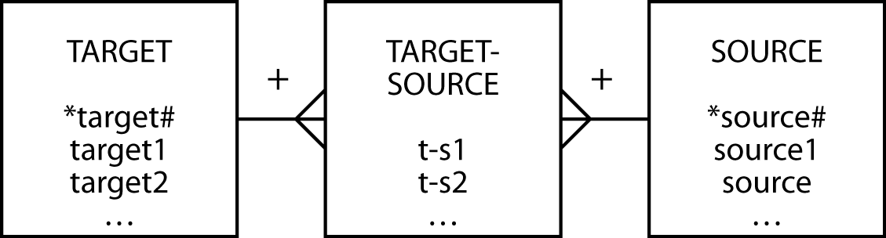
A template for divide
Find the target1 that have appeared in all sources
SELECT target1 FROM target
WHERE NOT EXISTS
(SELECT * FROM source
WHERE NOT EXISTS
(SELECT * FROM target-source
WHERE target-source.target# = target.target#
AND target-source.source# = source.source#));
Put all targets in your (outer) shortlist. Take the first target.
Put all sources in your (inner) shortlist. Pick the first source.
If the target is indeed associated with this source even once, then drop the source from the inner shortlist. Go to the next source on this shortlist. And so on…
If there is even one source found in the inner shortlist, drop the target from the outer shortlist.

Slide 27
Beyond the great divide
Find the items that have appeared in all sales
can be rephrased as
Find all the items for which the number of sales that include this item is equal to the total number of sales.
SELECT item.itemno, item.itemname
FROM item, lineitem
WHERE item.itemno = lineitem.itemno
GROUP BY item. itemno, item.itemname
HAVING COUNT(DISTINCT saleno)
= (SELECT COUNT(DISTINCT saleno) FROM sale);
First determine the number of sales in which an item has appeared
Second compare the number of sales to the total number of sales

Slide 28
Set operations
Lesson 5
UNION
Equivalent to OR
INTERSECT – Omitted from syllabus
Equivalent to AND

Slide 29
UNION
List all items that were sold on January 16, 2011, or are brown.
SELECT itemname FROM item, lineitem, sale
WHERE item.itemno = lineitem.itemno
AND lineitem.saleno = sale.saleno
AND saledate = '2011-01-16'
UNION
SELECT itemname FROM item WHERE itemcolor = 'Brown';
itemname
Hammock
Map case
Pocket knife—Avon
Pocket knife—Nile
Safari chair
Stetson
Tent—2 person
Tent—8 person

Slide 30
INTERSECT
List all items that were sold on January 16, 2011, and are brown.
SELECT itemname FROM item, lineitem, sale
WHERE item.itemno=lineitem.itemno
AND lineitem.saleno=sale.saleno
AND saledate = '2011-01-16'
INTERSECT
SELECT itemname FROM item WHERE itemcolor = 'Brown';
itemname
Pocket knife—Avon
INTERSECT not supported by MySQL

Slide 31
Class Exercise 4
You are given three databases (DBWestCoast, DBEastCoast, DBCorporate) each having a Customer table. You are asked to extract Customers who are male and are between 40 and 45 years old (inclusive) from each database and save this data as a single separate table. Write a UNION query.

Slide 32
Application
For products 1, 2 & 7 list in one row and three respective columns each product’s total unit sales; label the three columns P1, P2, P3.
For each product, display in ascending order, by product ID, the product ID and description, along with the customer ID and name for the customer who has bought the most of that product; also show the total quantity ordered by that customer (who has bought the most of that product). Use a correlated subquery.

Slide 33
Application (cont’d)
identify an additional three distinct SQL-generated reports to assist in making important business decisions.
For inventory managers
For marketing managers
For accounting

Slide 34
Conclusion
Introduced
m:m relationship
Associative entity
Weak entity
EXISTS
Divide
Set operations

Slide 35
Next Week
Week 5
Complete textbook problems
Complete homework assignment
Proceed with term project
Quiz (chapter 6)
Midterm exam review

